Slide 1
FMGC SALES CAMPAIGN ANALYSIS

Slide 2
INTRODUCTION
SUPERMART is a retail giant with over 50 supermarkets in the southern region of India. All their 50 stores ran a massive promotion during the Diwali 2023 and Sankranti 2024 (festive time in India) on their branded products. Now the sales director wants to understand which promotions did well and which did not so that they can make informed decisions for their next promotional period.
Promotional campaigns play a crucial role in the retail industry, driving sales and attracting customers during festive seasons. This project aims to analyze the performance of promotional campaigns conducted by super mart during Diwali 2023 and Sankranti 2024. By leveraging data analytics, we seek to gain insights into the effectiveness of these campaigns and provide recommendations for optimizing future marketing strategies.

Slide 3
𝗞𝗲𝘆 𝗧𝗮𝘀𝗸𝘀 𝗮𝗻𝗱 𝗙𝗶𝗻𝗱𝗶𝗻𝗴𝘀:
𝗗𝗮𝘁𝗮 𝗘𝘅𝗽𝗹𝗼𝗿𝗮𝘁𝗶𝗼𝗻: I meticulously explored sales data, examining trends, customer behaviour, and product performance during the festive period.
𝗣𝗿𝗼𝗺𝗼𝘁𝗶𝗼𝗻 𝗘𝗳𝗳𝗲𝗰𝘁𝗶𝘃𝗲𝗻𝗲𝘀𝘀: Using SQL queries, I assessed the impact of various promotions on sales volume, revenue, and customer engagement.
𝗣𝗼𝘄𝗲𝗿 𝗕𝗜 𝗗𝗮𝘀𝗵𝗯𝗼𝗮𝗿𝗱: To visualize the results, I created an interactive Power BI dashboard. It revealed which promotions resonated with customers and which fell short.

Slide 4
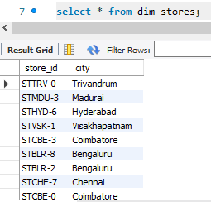
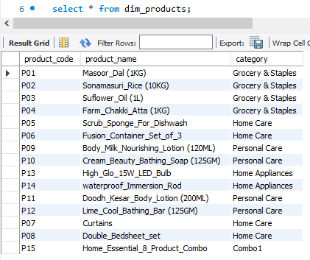
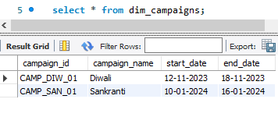
DATA SETS:
The main datasets used include dim_campaigns, dim_products, dim_stores, and sales_summary. These datasets contain information about product sales, store locations, promotional events, and campaign revenues.

Slide 5
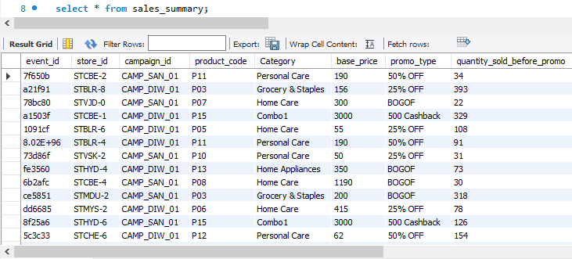
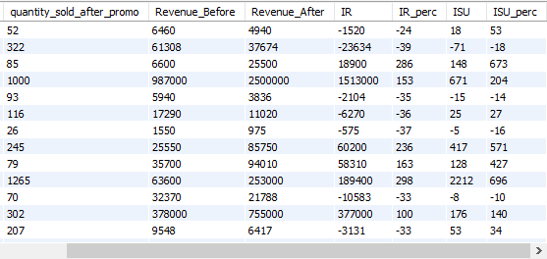

Slide 6
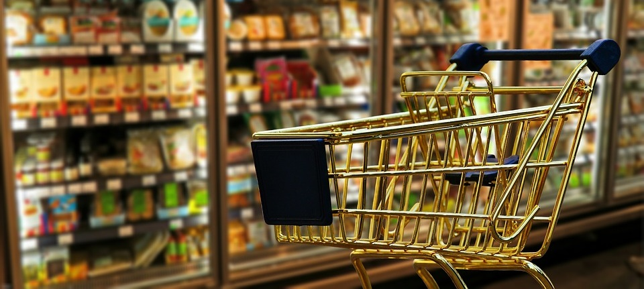
MYSQL QUERIES

Slide 7
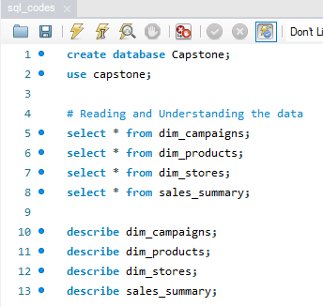
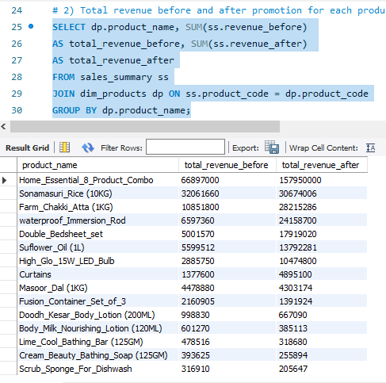
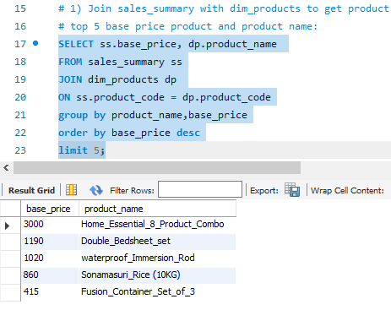

Slide 8
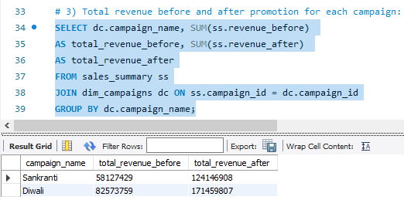
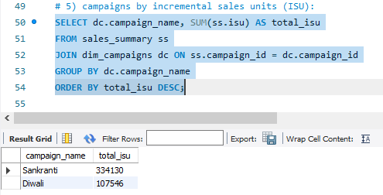
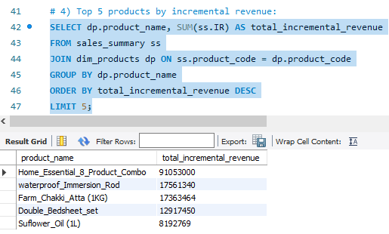
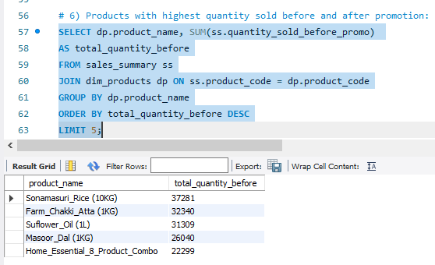

Slide 9
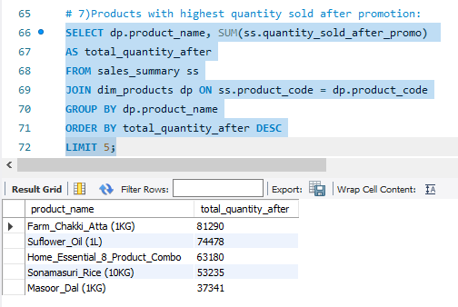
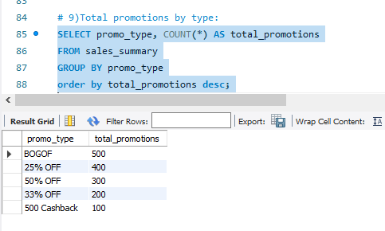
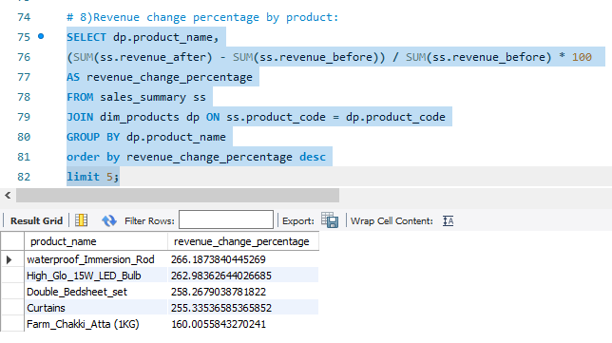
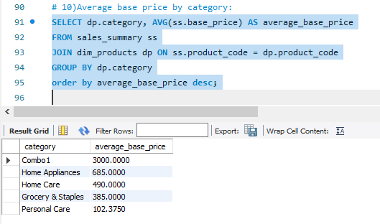

Slide 10
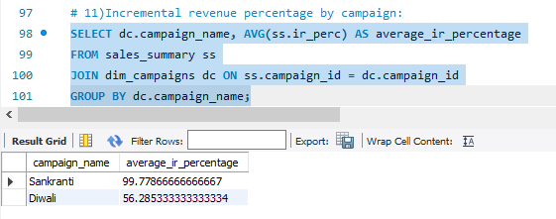
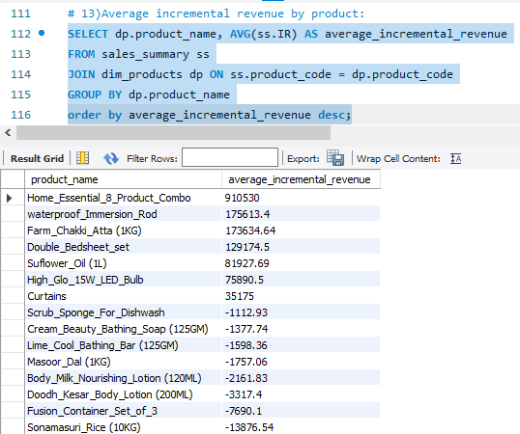
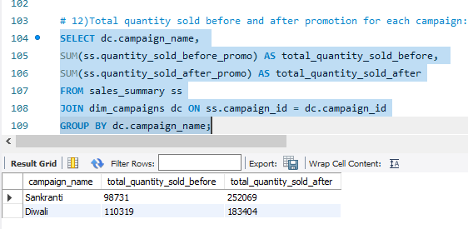

Slide 11
POWER BI ANALYSIS

Slide 12
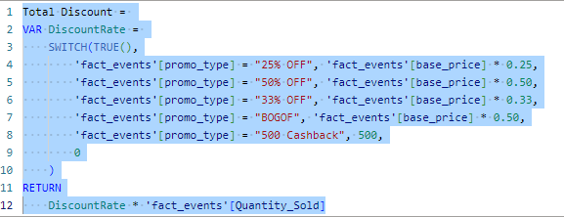
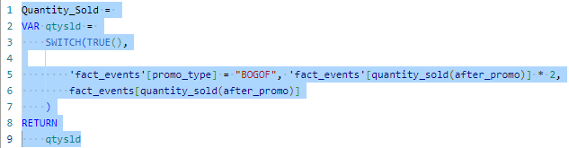
DAX QUERIES

Slide 13
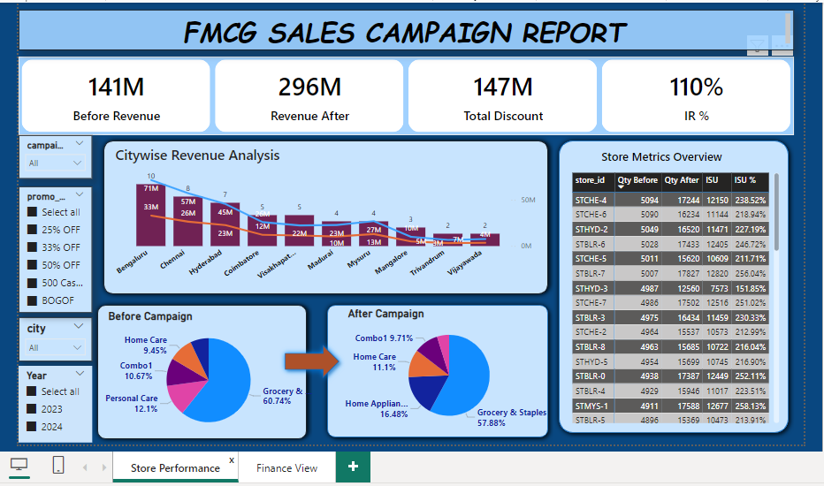

Slide 14
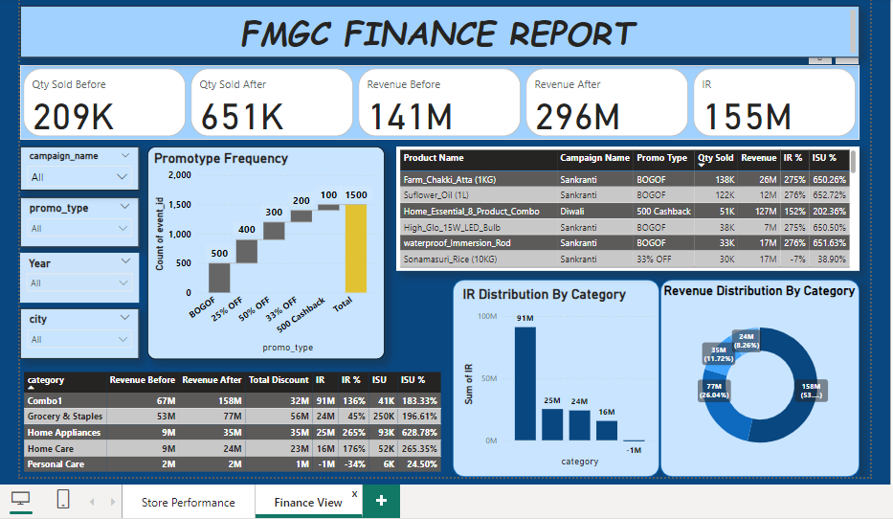

Slide 15
Results and Insights
The analysis revealed several key insights:
High-value products featured in 'BOGOF' promotions.
Distribution of stores across different cities.
Total revenue generated before and after each promotional campaign.
Incremental sold quantity and revenue percentage during the Diwali campaign.
Top 5 products ranked by incremental revenue percentage.
These insights can help Super Mart make informed decisions for future promotional activities, optimize resource allocation, and improve overall sales performance.

Slide 16
The campaign resulted in a significant increase in revenue from 141M to 296M.
Incremental revenue (IR) is 155M, with a notable IR percentage of 110%.
BOGOF promotions were the most frequent, contributing significantly to the increase in quantity sold and revenue.
The city-wise analysis indicates that Bengaluru had the highest revenue both before and after the campaign.
Stores like STCHE-4 and STCHE-5 saw the highest improvement in store performance.
Categories like Grocery & Staples and Combo1 showed the highest revenue and ISU % post-campaign.

Slide 17
Conclusion
Overall, the analysis provides valuable insights into the performance of promotional campaigns conducted by Super Mart during Diwali 2023 and Sankranti 2024. By leveraging data analytics, Super Mart can enhance its marketing strategies, attract more customers, and drive higher sales during festive seasons.

Slide 18
Limitations and Challenges
One significant limitation encountered during the analysis is related to the handling of promotions with the 'BOGOF' (Buy One Get One Free) promotion type. The dataset does not accurately account for the quantity of the free item provided as part of the promotion. This limitation may lead to some discrepancies or misunderstandings in the analysis, particularly when evaluating the effectiveness of 'BOGOF' promotions and comparing them with other promotion types.

Slide 19


